Slide 1
Majestic Forts
Introduction
Forts have stood as symbols of power, protection, and architectural brilliance for centuries. Built for defense, administration, and strategic dominance, these structures provide a glimpse into the historical, cultural, and military advancements of different civilizations. From the grandeur of European castles to the imposing forts of India, these structures continue to captivate historians and tourists alike.

Slide 2
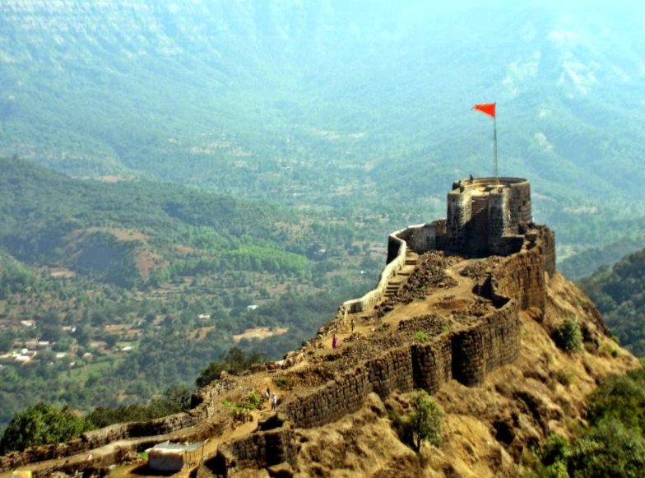
Pratapgad
Pratapgad is a mountain fort located in Satara district, in the Western Indian state of Maharashtra. The fort is situated 24 kilometres from the Mahabaleshwar hill station. The fort is now a popular tourist destination.
The fort's historical significance is due to the Battle of Pratapgad, which took place here on 10 November 1659, between Chatrapati Shivaji Maharaj and Bijapur Sultanate general Afzal Khan.[3][4] The fort was constructed on a hilltop, about 1,080 meters above sea level, offering stunning views of the surrounding landscapes.

Slide 3
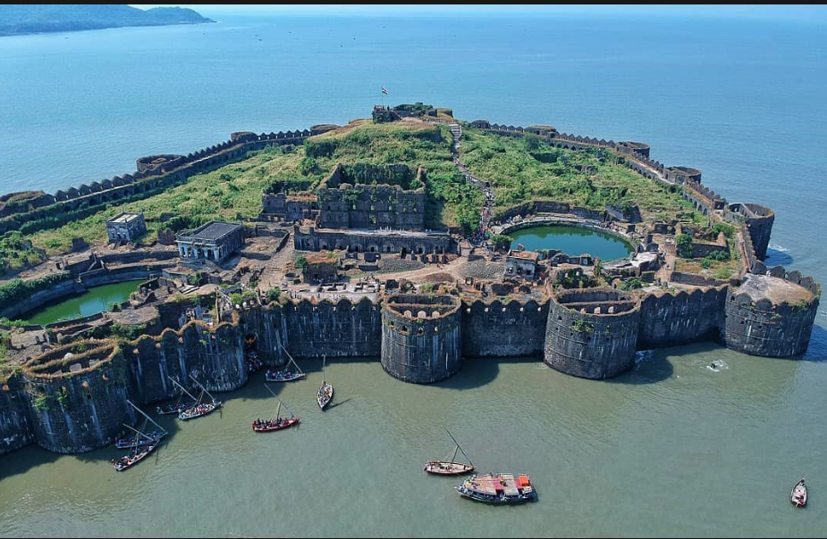
Janjira
Murud-Janjira (pron.ⓘ) is the local name of a famous fort and tourist spot situated on an island just off the coastal town of Murud, in the Raigad district of Maharashtra, India.[1] Malik Ambar is credited with the construction of the Janjira Fort in the Murud Area of present-day Maharashtra India.[2] After its construction in 1567 AD, the fort was key to the Sidis withstanding various invasion attempts by the Marathas, Mughals, and Portuguese to capture Janjira.[3]

Slide 4
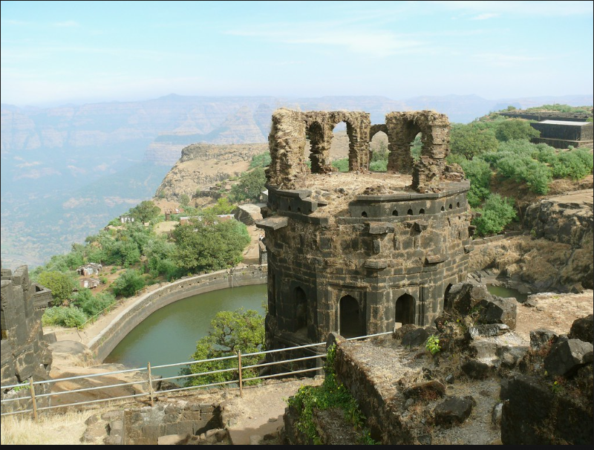
Raigad
Raigad, seen in the Raigad district of Maharashtra, India, is a hill fort located in the city of Mahad. It is one of the strongest fortress on the Deccan Plateau and was historically referred to as Rairee or Rairy fort.[1]
Chhatrapati Shivaji Maharaj, the Maratha ruler, along with his chief engineer Hiroji Indulkar, did the construction and development of various buildings and structures, including Raigad. In 1674, after being crowned the king of the Maratha Kingdom of the Konkan, Shivaji Maharaj chose Raigad as the capital of his Hindavi Swaraj.[2]

Slide 5

Torana
Torna Fort, also known as Prachandagad, is a hill-fort in the district. The name derives from Prachanda (Marathi for huge or massive) and gad (Marathi for fort)
Torna fort zunjar machi fortification
This frt is believed to have been constructed by the Shiva Panth in the 13th century. A Menghai Devi temple, also referred to as the Tornaji temple, is situated near the entrance of the fort. Malik Ahmed, a Bahamani ruler, captured this fort during the reign of Alauddin Khilji during the late 1470s.

Slide 6
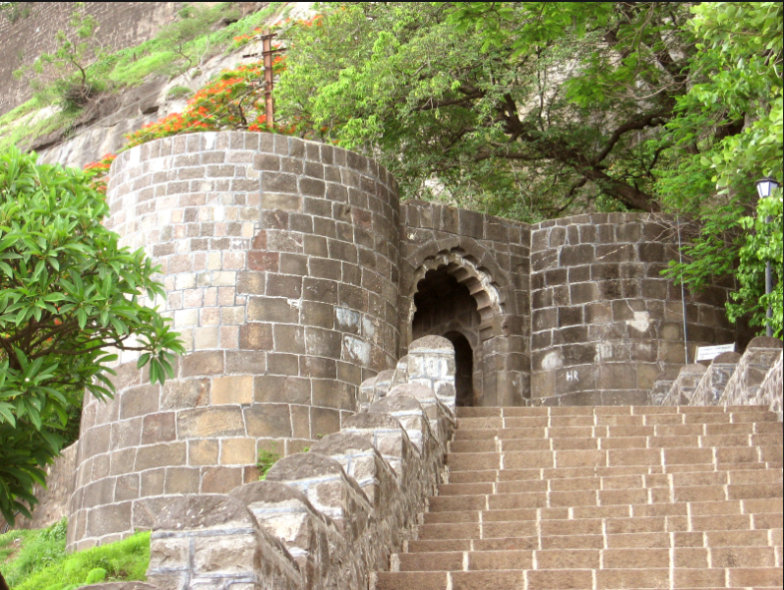
Shivneri
Shivneri got its name as it was under the possession of the Yadavas of Devagiri. This fort was mainly used to guard the old trading route from Desh to the port city of Kalyan. The place passed on to the Bahmani Sultanate after the weakening of Delhi Sultanate during the 15th century and it then passed on to the Ahmadnagar Sultanate in the 16th century. In 1595, a Maratha chief named Maloji Bhosale, the grandfather of Chhatrapati Shivaji Maharaj, was ennobled by the Ahmadnagar Sultan, Bahadur Nizam Shah and he gave him Shivneri and Chakan. Shivaji maharaj was born at the fort on 19 February 1630, and spent his childhood there.

Slide 7
Thank you..!!

